Slide 1
Systematic Modelling Of Safety Critical Systems Using SysML V2
MASTER THESIS
Presented by: Priyanka Antony
532455
11.11.2025

Slide 2
Contents
Introduction
Background
Methodology
Systematic modelling –Case Study
Modelling construct specific to SysML V2
Evaluation and Conclusion

Slide 3

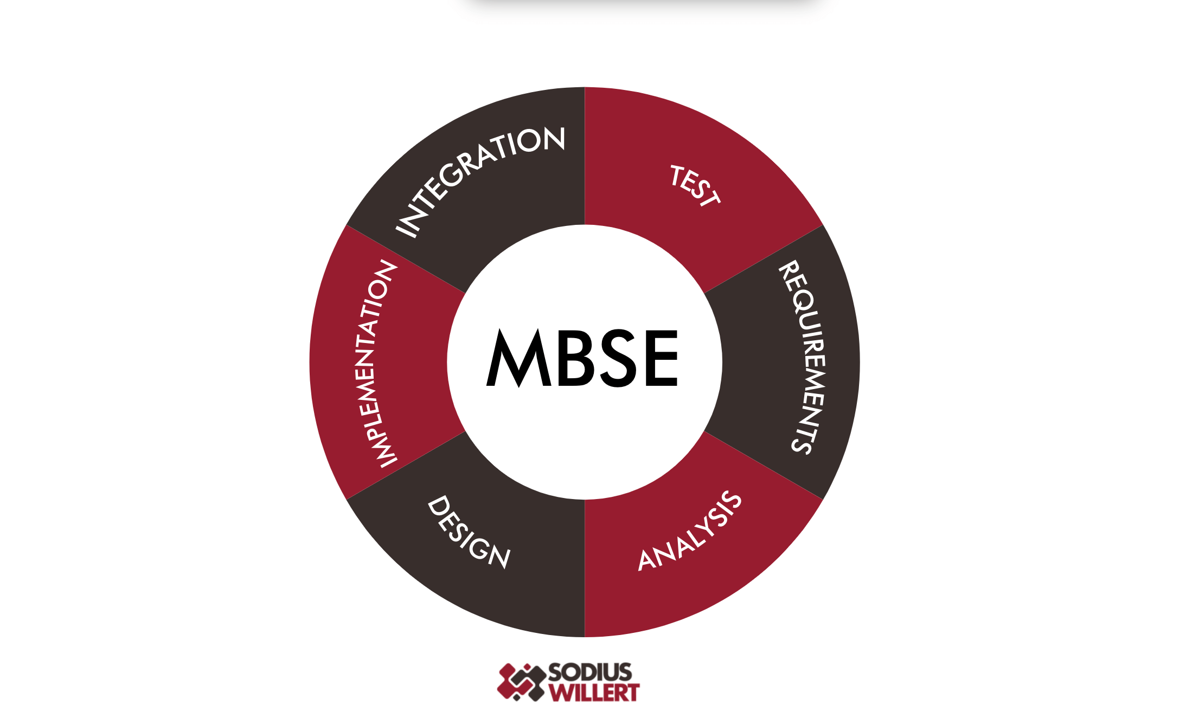
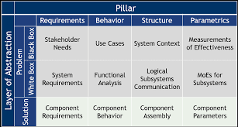
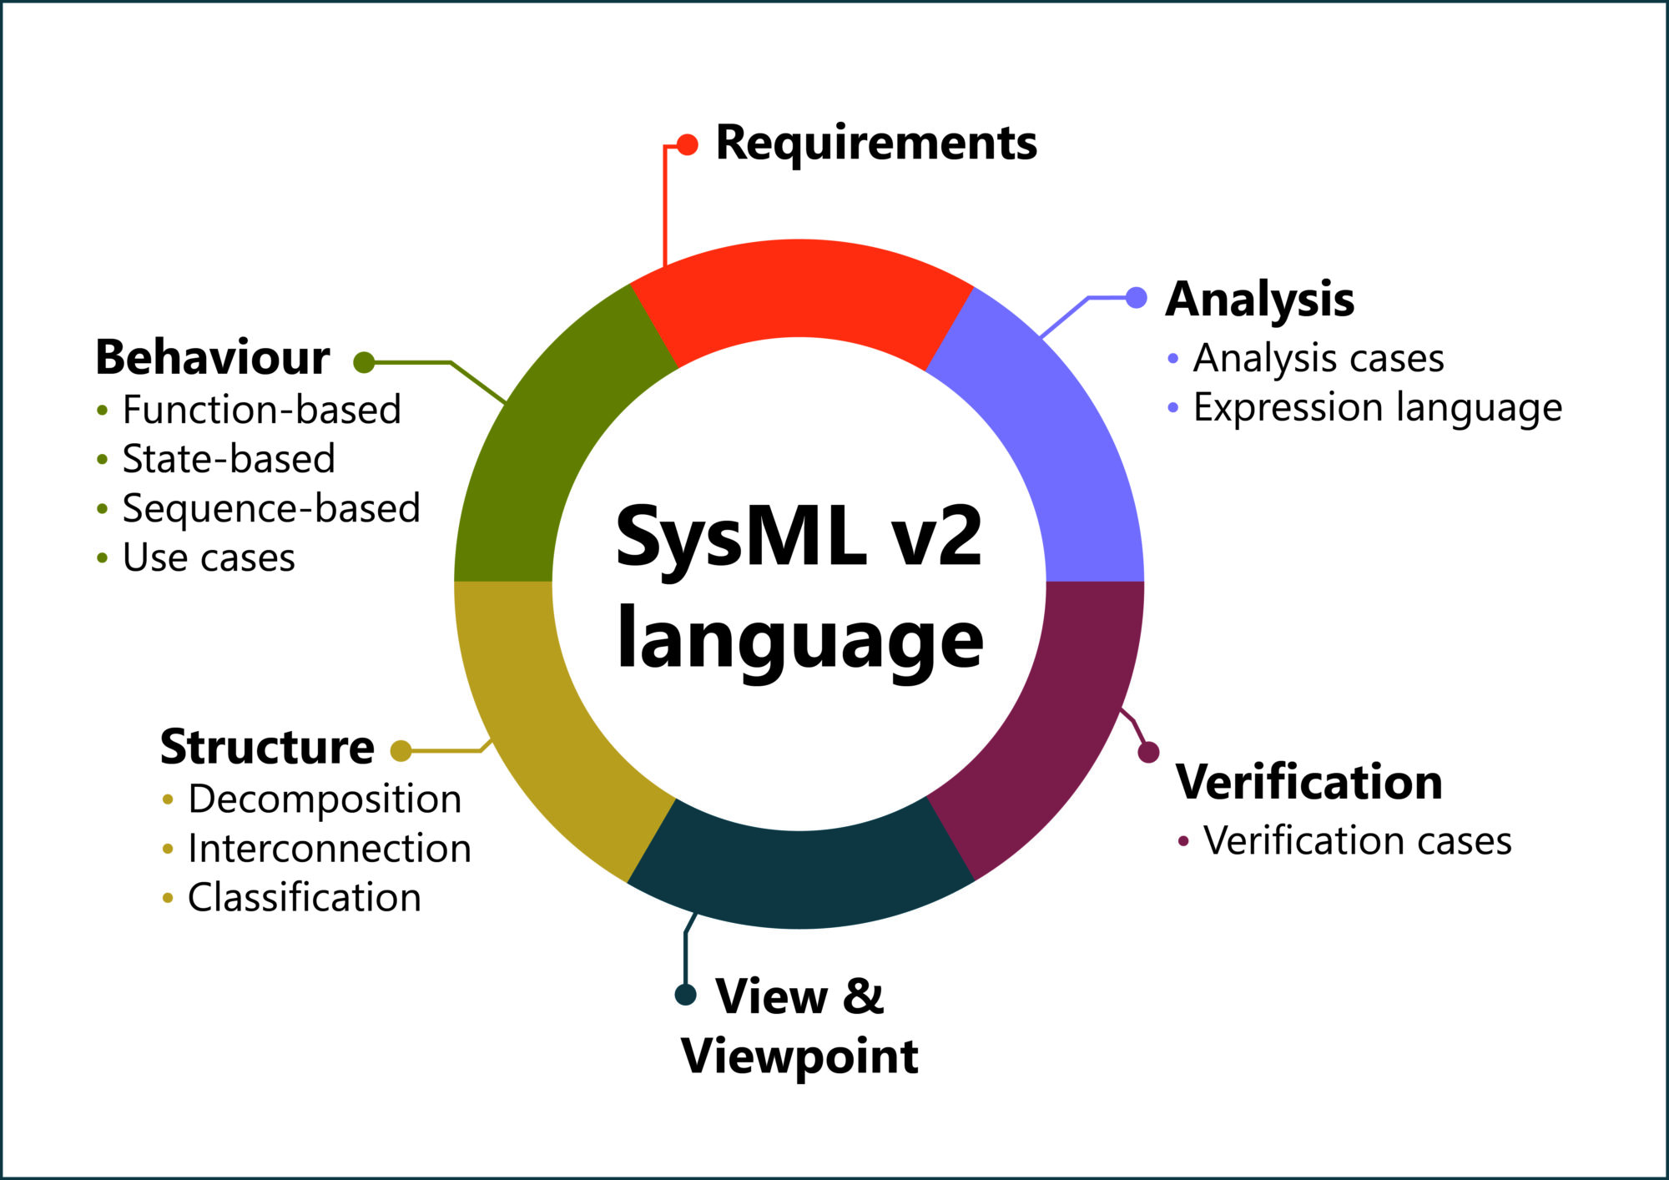
Introduction
MBSE
HAP
SysML V2
MAGIC GRID

Slide 4
Background

Slide 5
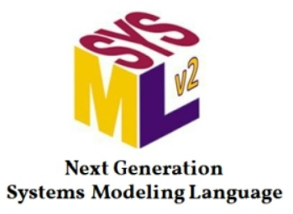
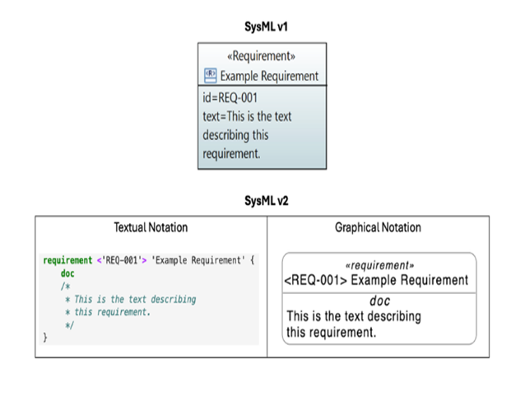
SysML V2
Parametric Modelling
Developed by OMG to support MBSE
Modelling with Graphical and Textual Notation
Reuse and Redefine
Handles variability
Improved traceability
Constraint modelling redefined
Better Support for Mathematics
Enhanced Interoperability
KerML Metamodel
Greater precision
Adapted from [1]

Slide 6
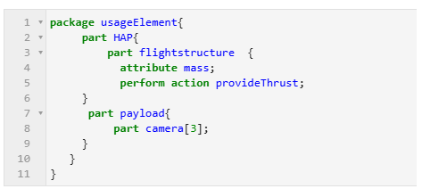
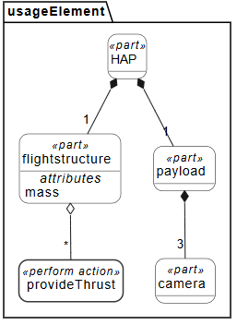
SysML V2 introduces -Dual Notation System
Textual notation
Graphical notation

Slide 7
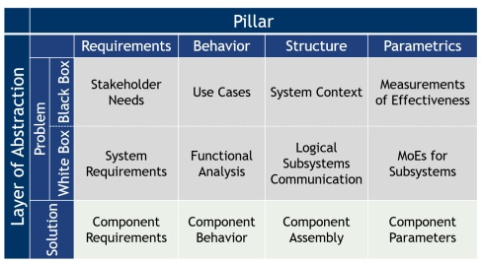
Magic Grid
MBSE Grid
Structured framework designed to guide
Rows - Abstraction layers or domains
Columns -Pillars
Adapted from [2]

Slide 8
HAP
Solar-powered unmanned aerial systems
Operate in the stratosphere
Developed by German Aerospace Centre (DLR)
Application
Earth observation
Real time data transmission
Disaster response
Adapted from [3]

Slide 9
Methodology

Slide 10
Motivation
Research Objectives
Enhance Complex System Modelling
Evaluate how SysML V2 improves over SysML V1.
To evaluate how the Magic Grid framework and SysML V2 can address the growing complexity of systems
Within the MBSE domain:
Integrate the Magic Grid and SysML V2
Develop a structured, domain-driven, systematic modelling approach
Illustrate the approach using HAP
Evaluate how SysML V2 innovations enhance system design compared to SysML V1

Slide 11




Tooling environment
Setting up the SysML-v2-Release Pilot Implementation using the official GitHub repositories.
SysML v2 Pilot Implementation using Jupyter Lab
SysML language Kernel
Setting up Docker environment
- Consistent, portable, isolated environment.
Containers:
-Gorenje SysML V2 pilot implementation using Jupyter Lab
-Eclipse Syson -SysON Graphical Visualisation Tool

Slide 12

Systematic modelling –Case Study

Slide 13
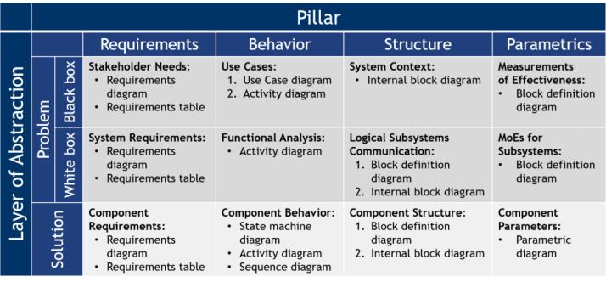
Problem domain: black-box
HAP system is viewed as a black box
System is observed in terms of its external behaviour and interactions
Adapted from [2]

Slide 14
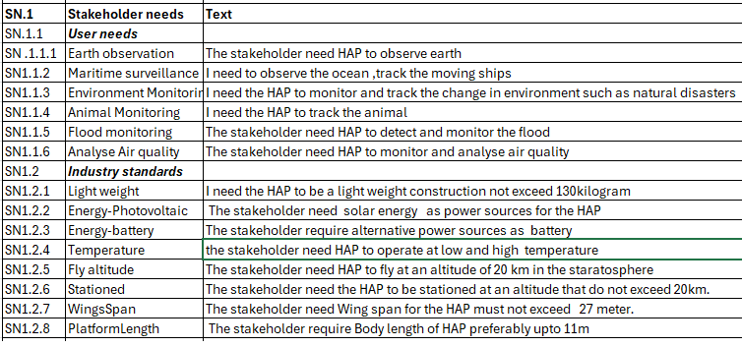
Problem domain: black-box
Stakeholders' needs are designed
Requirement table
Requirement diagram.

Slide 15
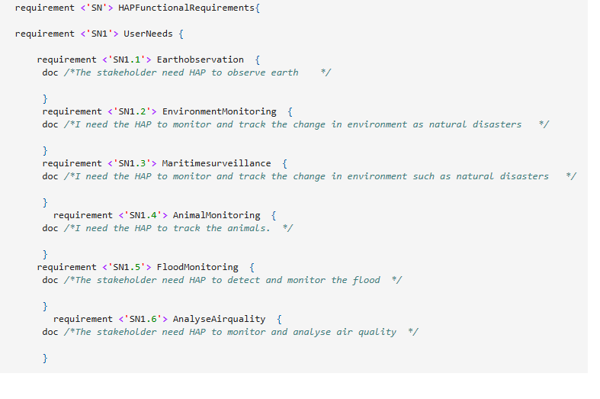
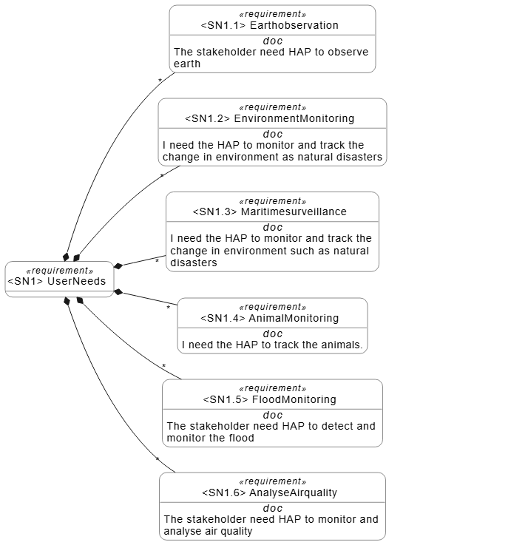
Black Box- Requirement Diagram
Textual Notation
Graphical Notation

Slide 16
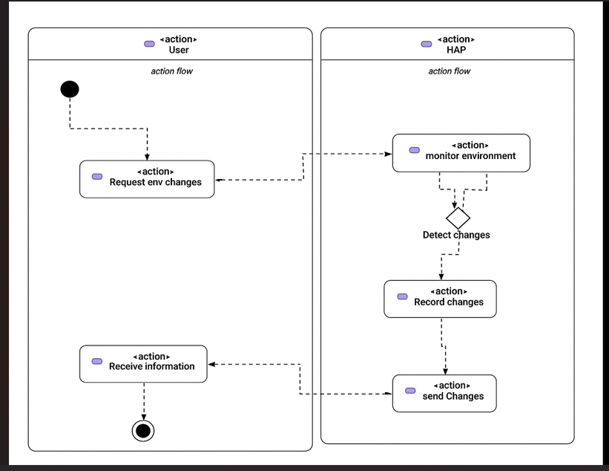
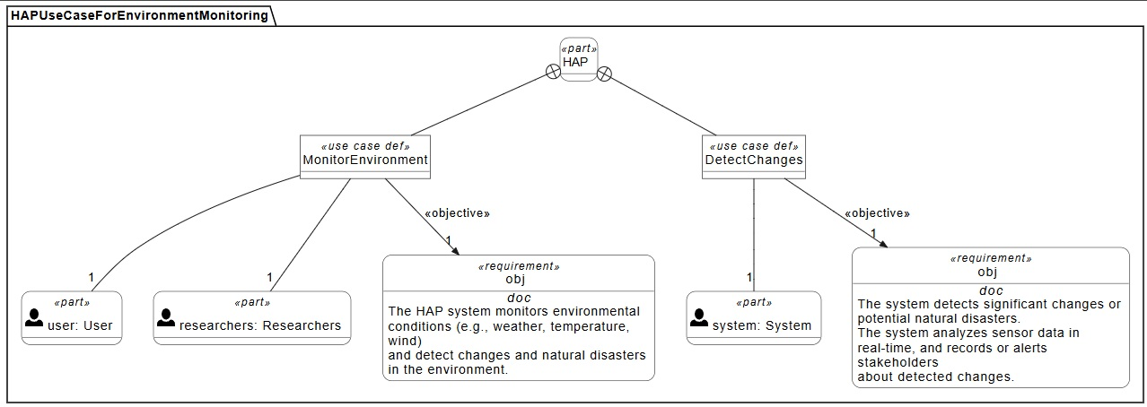
Black Box - Behaviour
Use Case Diagram
Activity Diagram

Slide 17
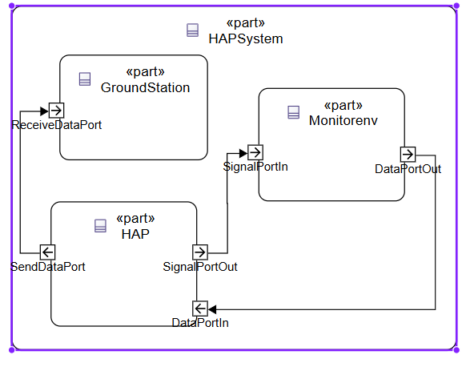
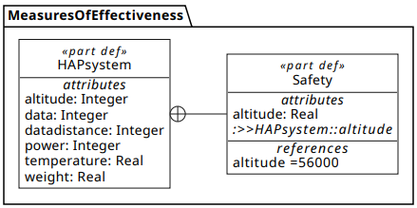
Black Box
Structure
Parametrics

Slide 18
Problem Domain : White Box
Explaining the internal structure and behaviour of HAP
Phase focuses on understanding what the system is expected to do.
Defining its internal structure, functions, and logic

Slide 19
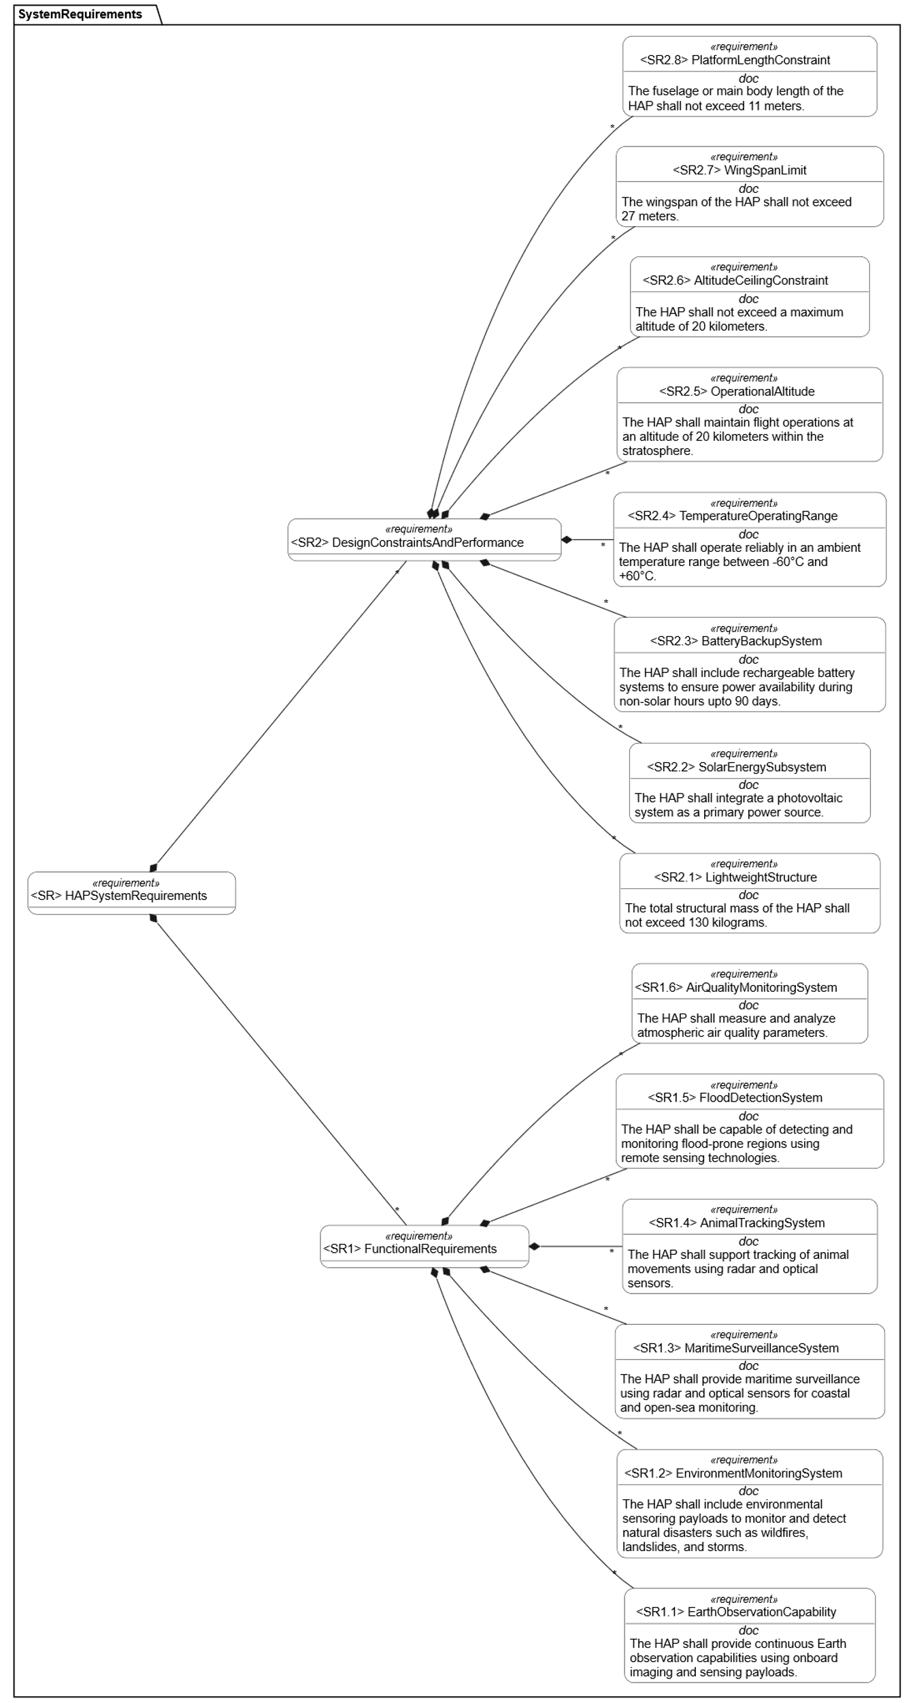
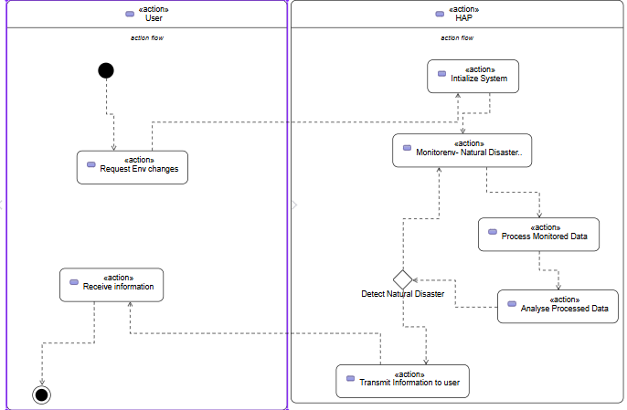
Problem Domain : White Box
System Requirement Diagram
Activity Diagram

Slide 20
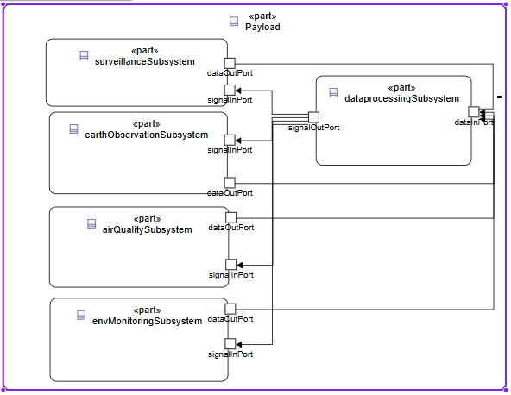
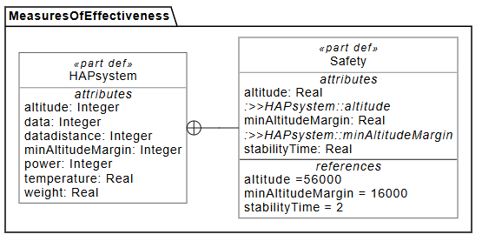
Problem Domain : White Box
Internal System Structure Diagram
Measures Of Effectiveness

Slide 21
Solution Level
The main goal of the solution architecture is to deliver a model of HAP that satisfies the requirement defined in the problem domain.
Ensures traceability

Slide 22
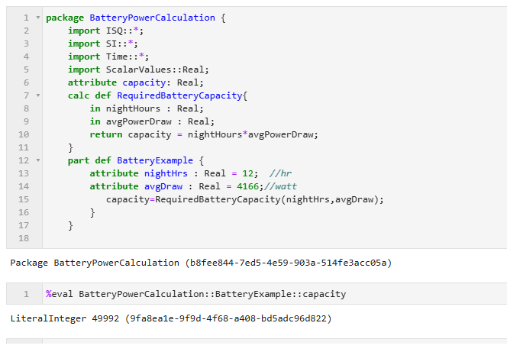
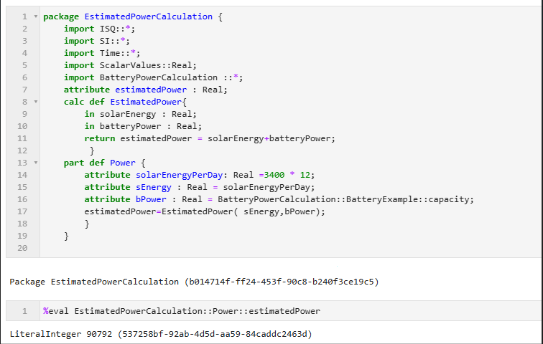
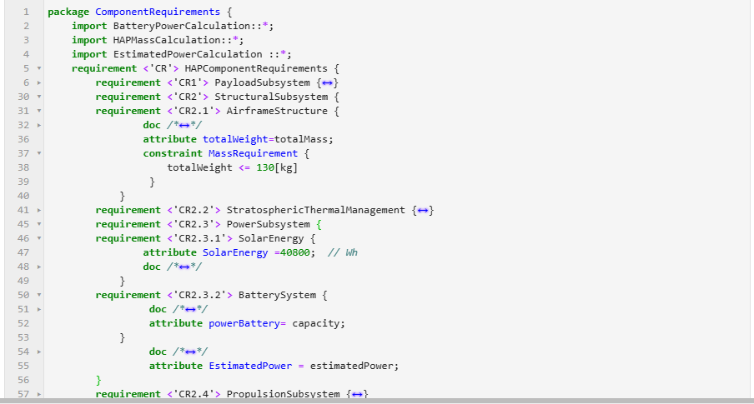
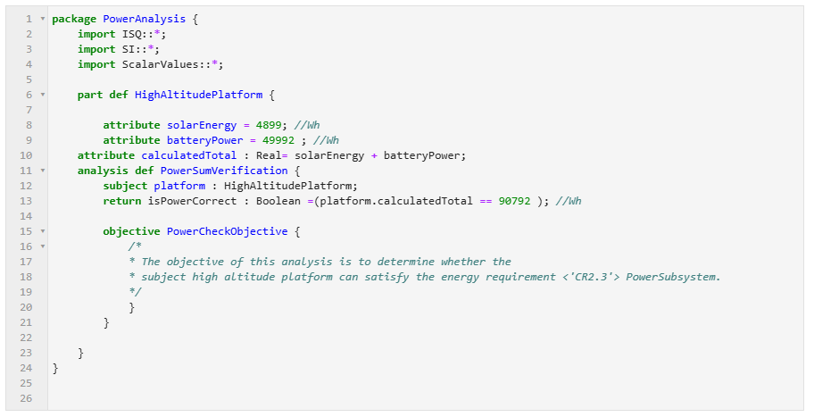
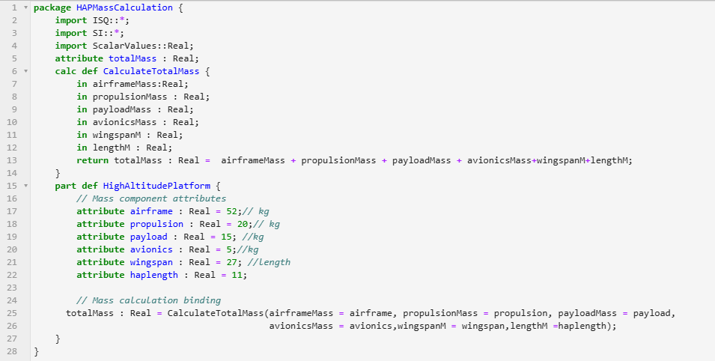
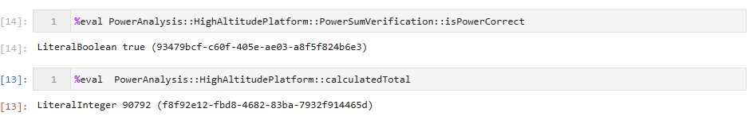
Component Requirements Textual Notation

Slide 23
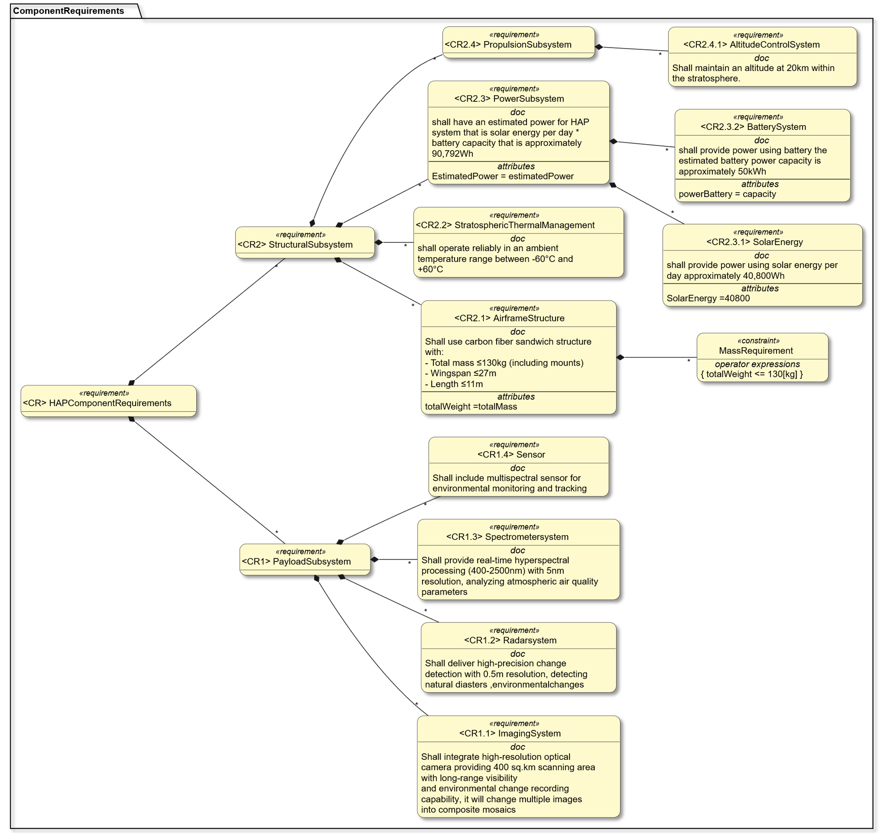
Component Requirements Graphical Notation
%viz along with the STYLE option that gives standard colour to the output generated.
%viz --view TREE --style LR --style STDCOLOR ComponentRequirements

Slide 24
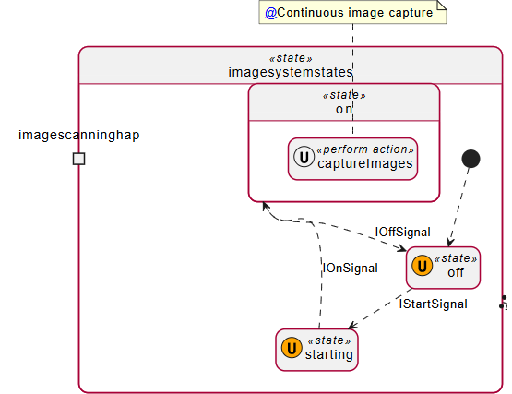
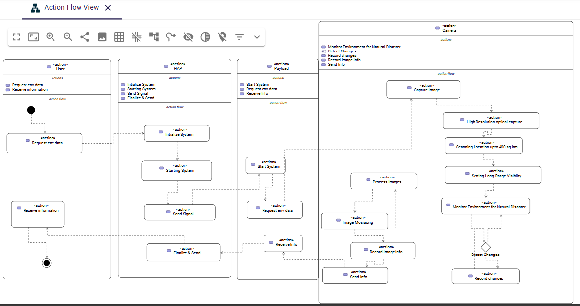
Component Behaviour
State Machine Diagrams
Activity Diagram

Slide 25
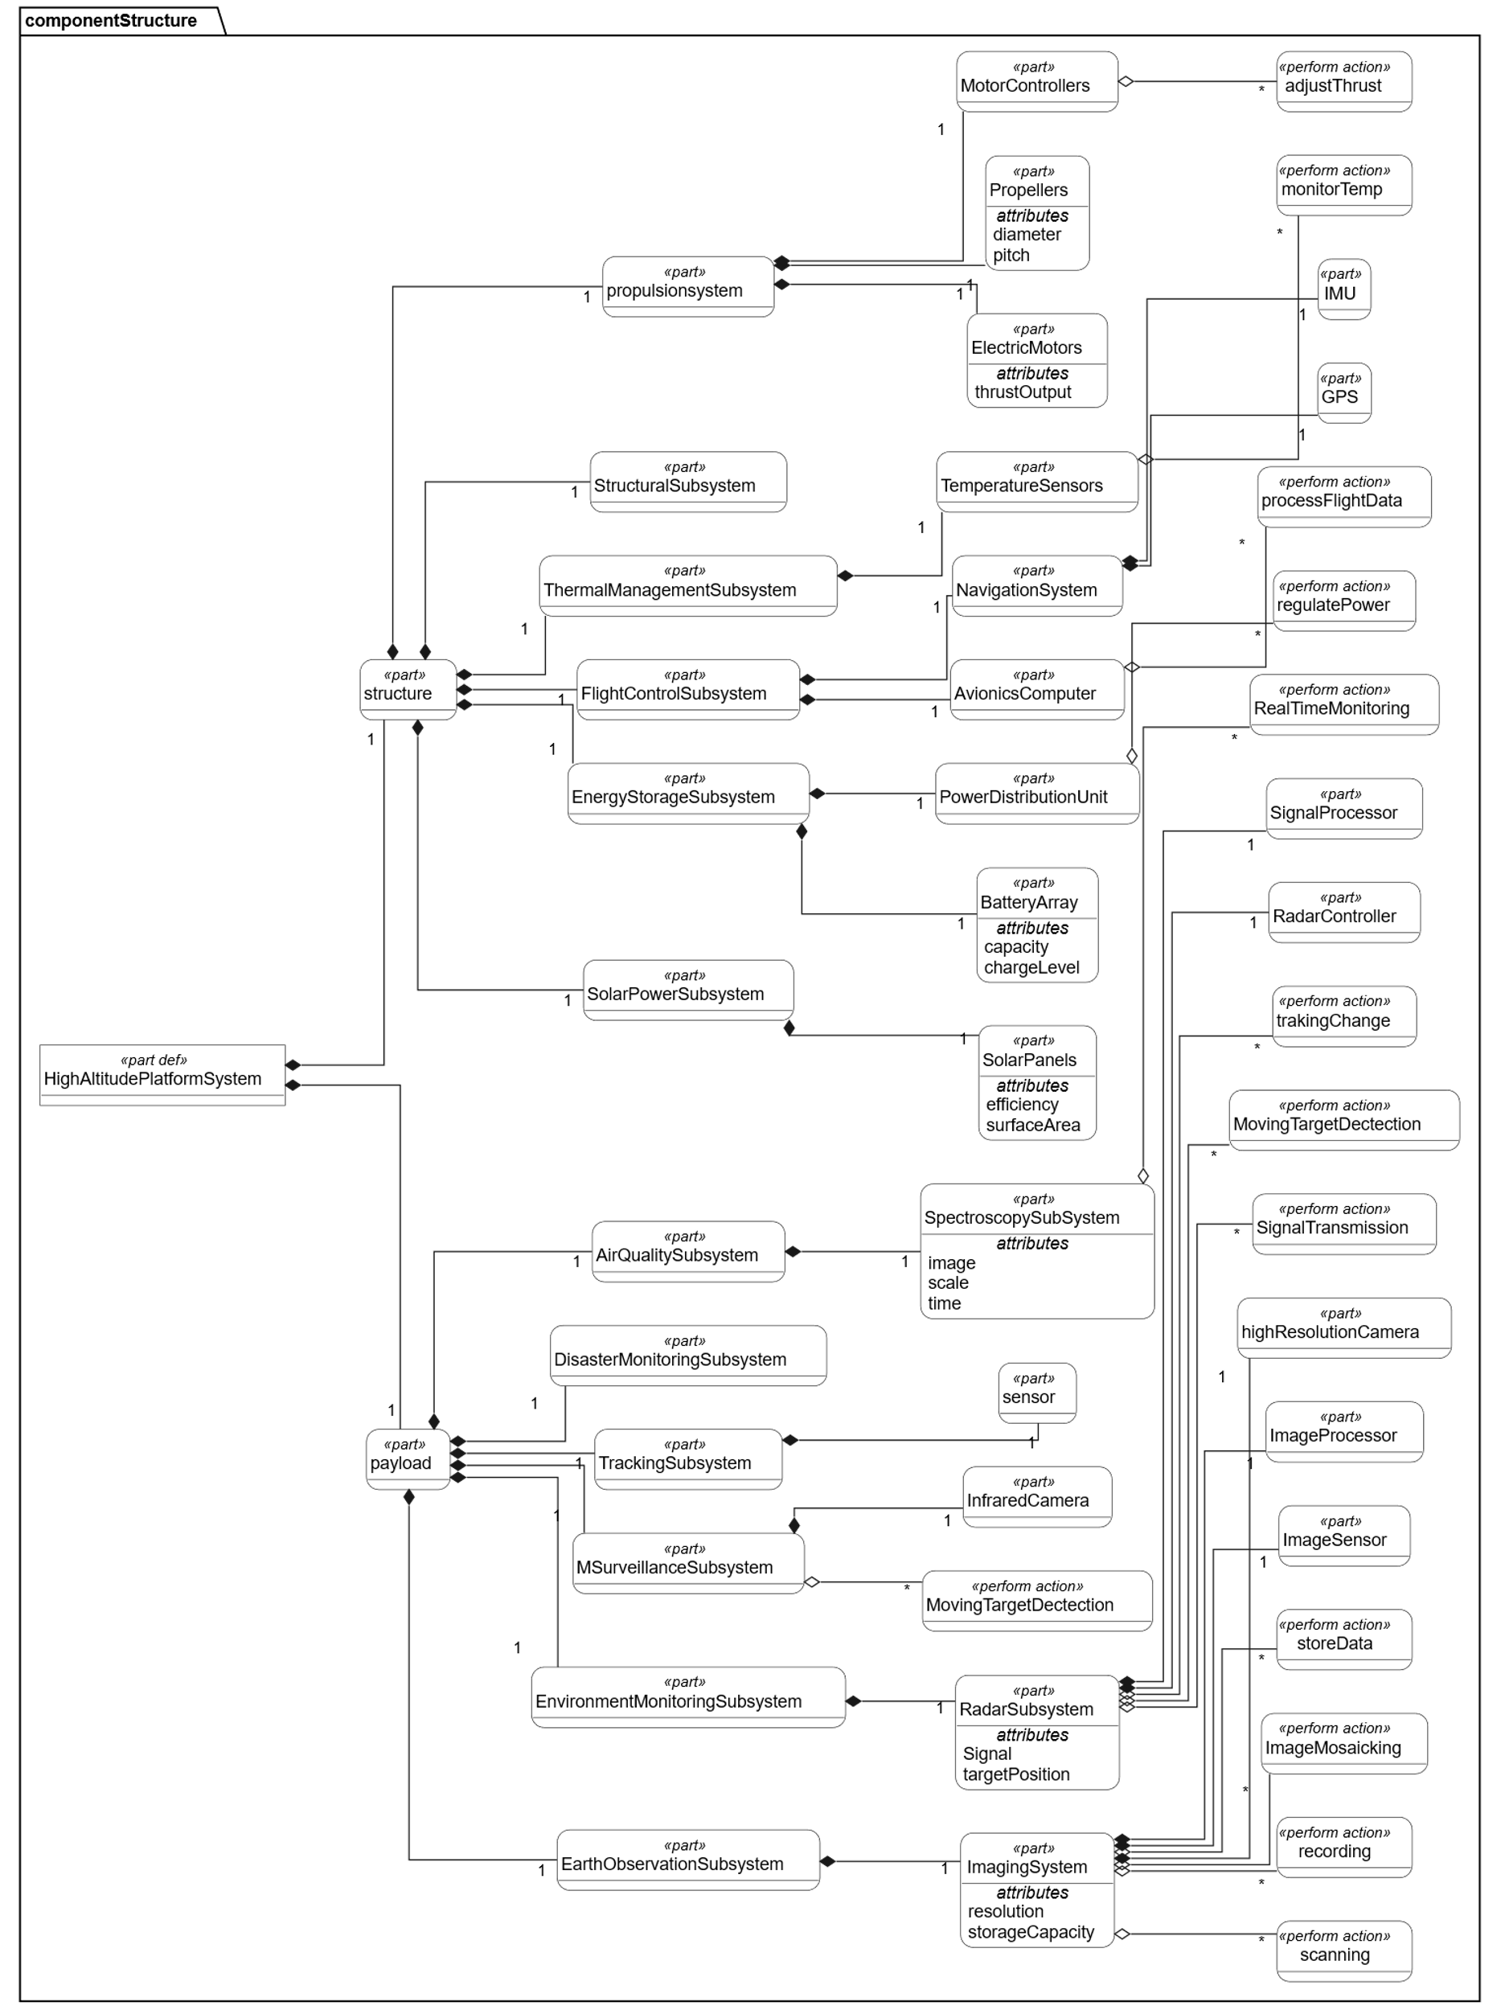
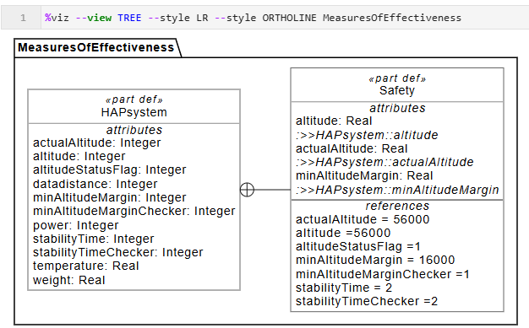
Component System Structure
Component Parameters

Slide 26
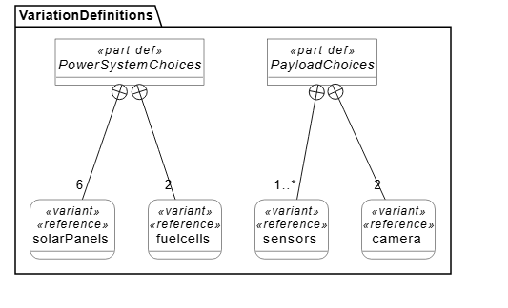
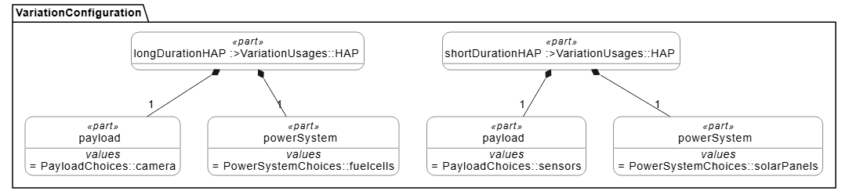
MODELLING CONSTRUCT SPECIFIC TO SYSML V2
Variability
Individuals and Snapshots
analysis case
view and viewpoints

Slide 27
EVALUATION & CONCLUSION
From Case study –V2 addresses the complexities
Scaling of SysML V2 in the MBSE Magic Grid is achieved.
3. As compared to SysML V1, new features: views and viewpoints , variability, individuals and snapshots, expressions, calculations, and analysis cases, are achieved in SysML V2.
4. Use of textual notation, implementing modelling is far easier.
5. Improved traceability is achieved
6. SysML V2 graphical notation using the SysON tool is achieved.
7. Improvement in the area of scalability, reuse, and collaboration.

Slide 28
Future work
Further refine and expand the integration of Magic Grid with SysML V2
Integrate SysML V2 models with simulation and verification tools to improve design accuracy
Apply the proposed modelling approach to other complex systems

Slide 29
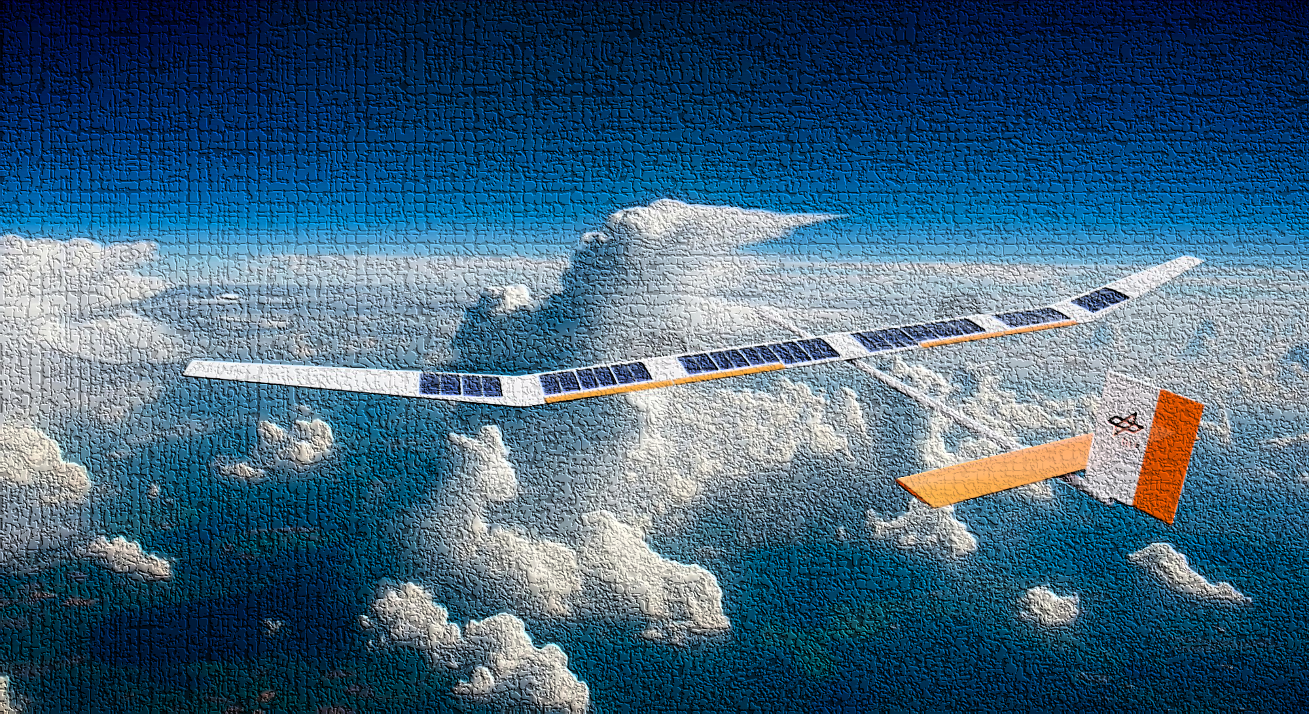


Slide 30
References for Used Figures
S. Team. Transitioning from SysML v1 to SysML v2: Textual Notation. https : //resources.sysgit.io/transitioning- from- sysml- v1- to- sysml- v2- textual-notation/. 2024.
A. Morkevicius, A. Aleksandraviciene, D. Mazeika, L. Bisikirskiene, and Z. Strolia. “MBSE grid: a simplified SysML-based approach for modeling complex systems”. In: INCOSE International Symposium. Vol. 27. 1. Wiley Online Library. 2017, pp. 136–150.
https://www.dlr.de/en/research-and-transfer/projects-and-missions/uncrewed-high-altitude-platform-hap-alpha

